Slide 1
Smart Fire Detector
“Today, smoking’s gunna save lives” - Dwight Schrute

Slide 2

Mission statement: To reduce response times to fires, reduce property damage from fire, and to provide an affordable solution to detecting fires more efficiently.

Slide 3
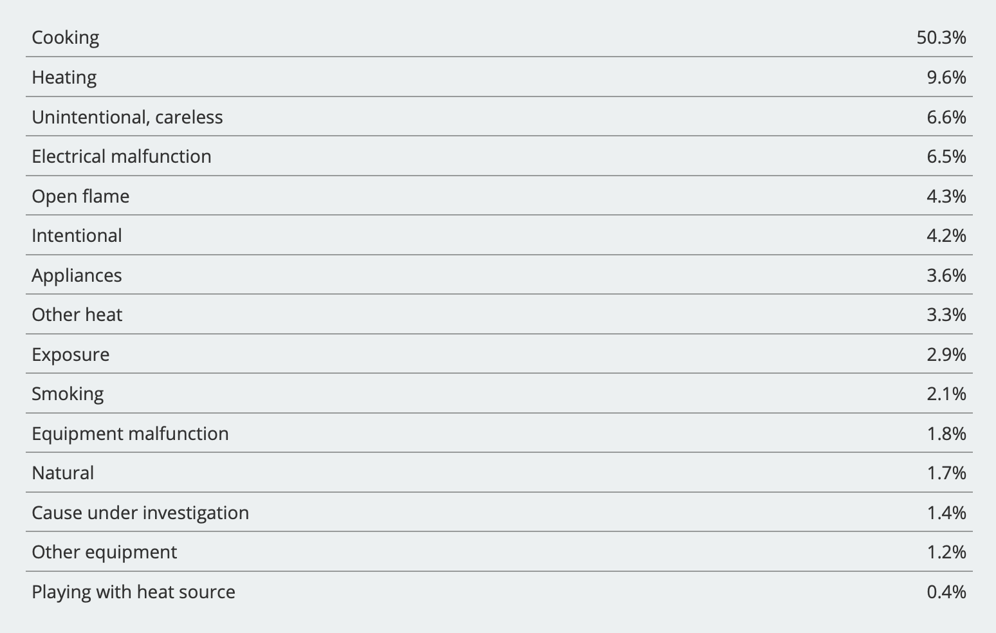
The problem
Fires are a devastating force that cause death, property damage, injuries and more. Once a fire grows, it takes time between the fire is detected and the time that 911 is called.
Fire stations have a limited amount of resources and time. Wasted resources come from false alarms, and time spent relaying information and redirecting calls.
https://www.usfa.fema.gov/data/statistics/#tab-4

Slide 4
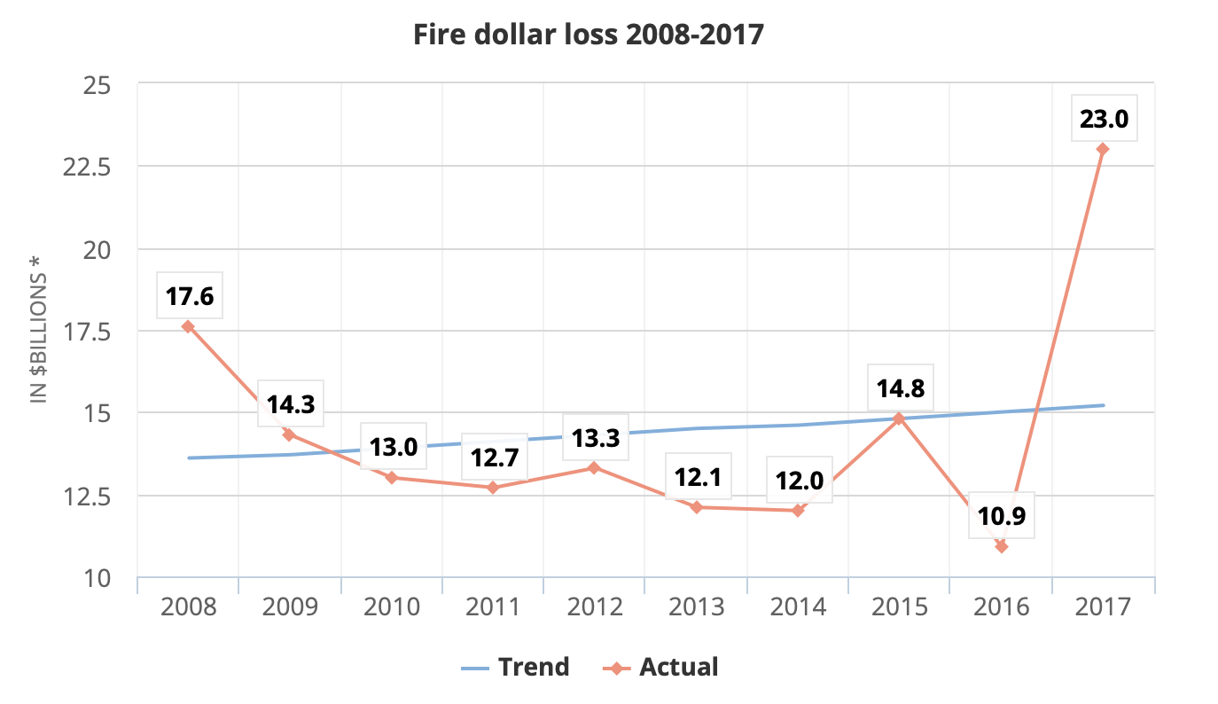
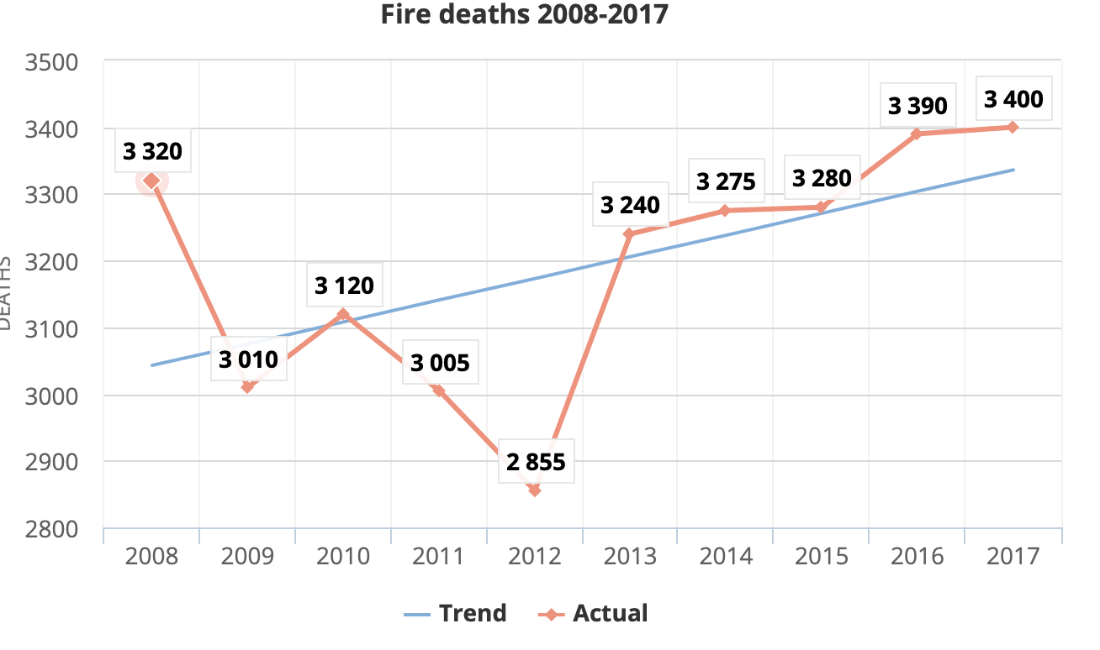
Statistics
https://www.usfa.fema.gov/data/statistics/#tab-4

Slide 5

The solution
An affordable smart fire detector that uses two sensors to confirm and detect fires more accurately and directly call 911 and the owner to report fires once detected. This can help reduce response time, and could help reduce property damage and save lives.

Slide 6
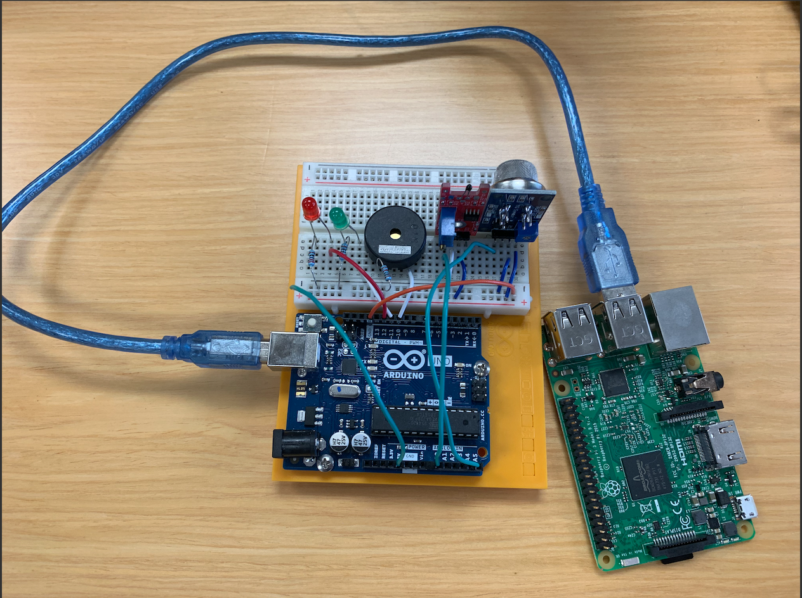
Smart Fire Detector
All parts from Amazon:
Raspberry Pi $35
Arduino Uno $8
Smoke Detector $7
Thermal Sensor $2.50
Buzzer $3.50
2 LED Lights $0.21
Total: $56.21

Slide 7
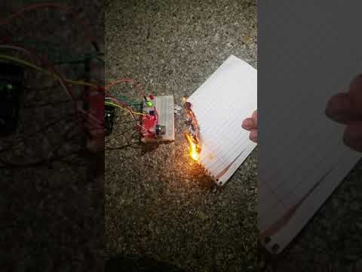
Demo

Slide 8
Future Development
October 20XX
January 20XX
June 20XX
March 20XX
Add functionality to send real-time stats and location of fire based on which detectors go off to display on a website in real time
Work with government to help streamline integration of fire detectors with 911 services
Work towards having the product become a standard fire alarm in residential and commercial buildings
Find cost-efficient options to have a fully-functional device through power outages and wi-fi outages
Allow user to input contact and home info through a fully-developed website to be notified
Provide statistics using stored records to help government determine high-risk areas
Work with manufacturers and insurance companies to help reduce cost of parts and make the detector cheaper and more accessible for everyone

Slide 9
How it works
Step 3
Step 2
Step 1
Raspberry Pi takes data from Arduino, and using Python Script, sends a text and call to the owner and authorities when signal is sent.
Sensors send off a signal, if the preset thresholds for each sensor are exceeded.
Arduino takes analog readings from thermal and smoke sensors.

Slide 10

Why now?
There has been a reported increase in deaths and property damage with fires within the last few years. With your help, we can make this accessible to everyone and make a difference in fighting fire.

